Slide 1

VV156 Final RC Part III
Sequence and Series
Chengyang Shi

Slide 2
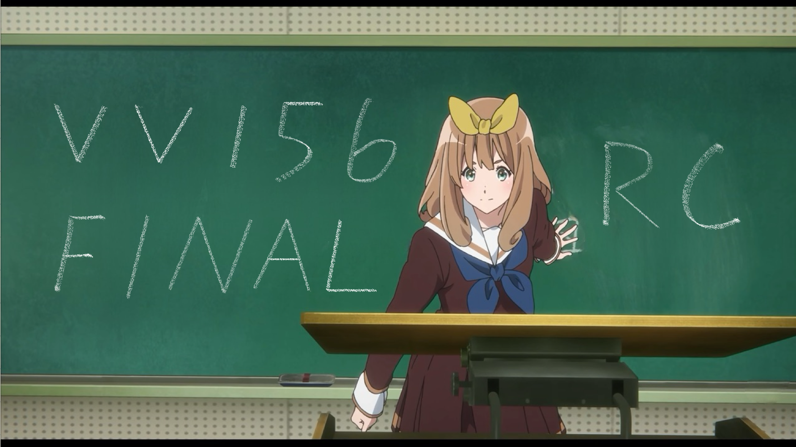

Slide 3
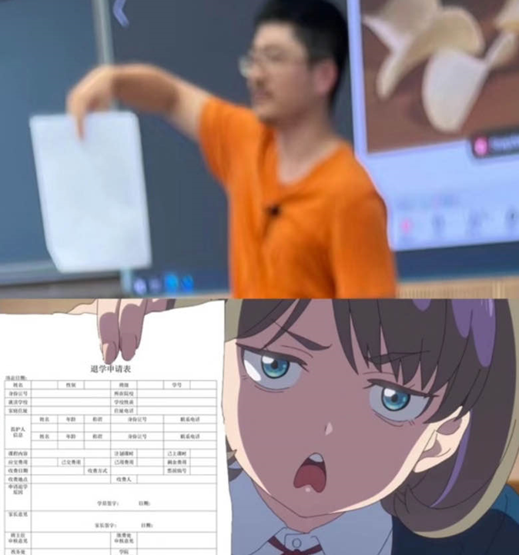
Contents
Sequences
Series
Test of Convergence
Power Series
Taylor Series

Slide 4
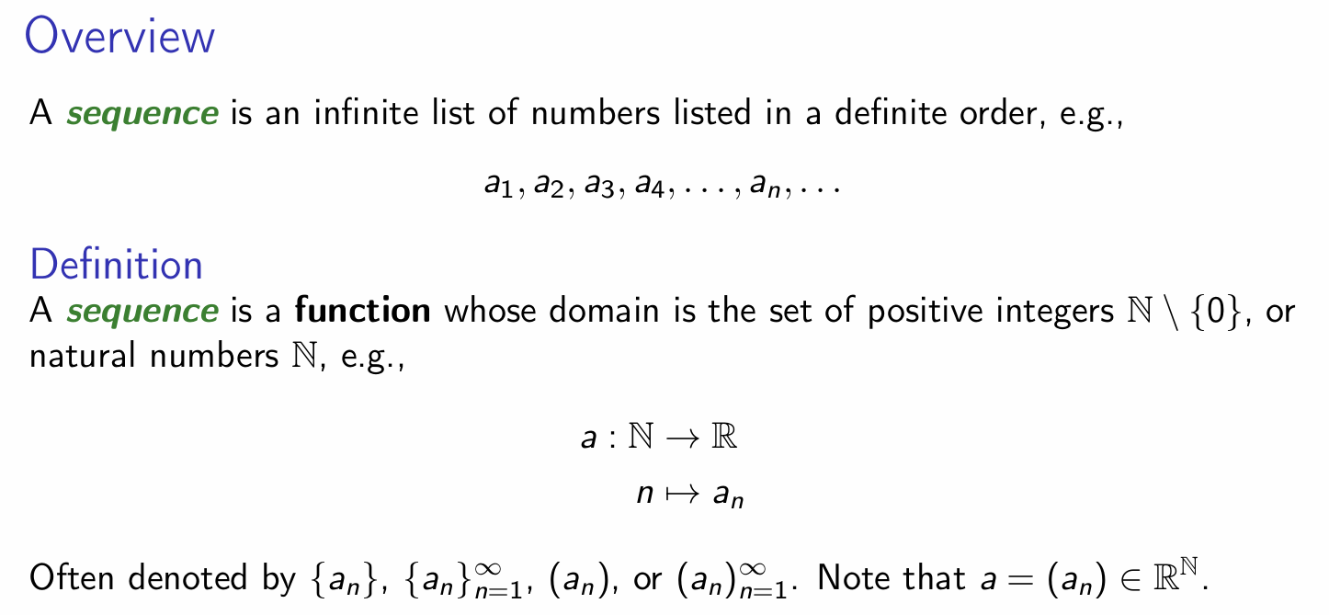
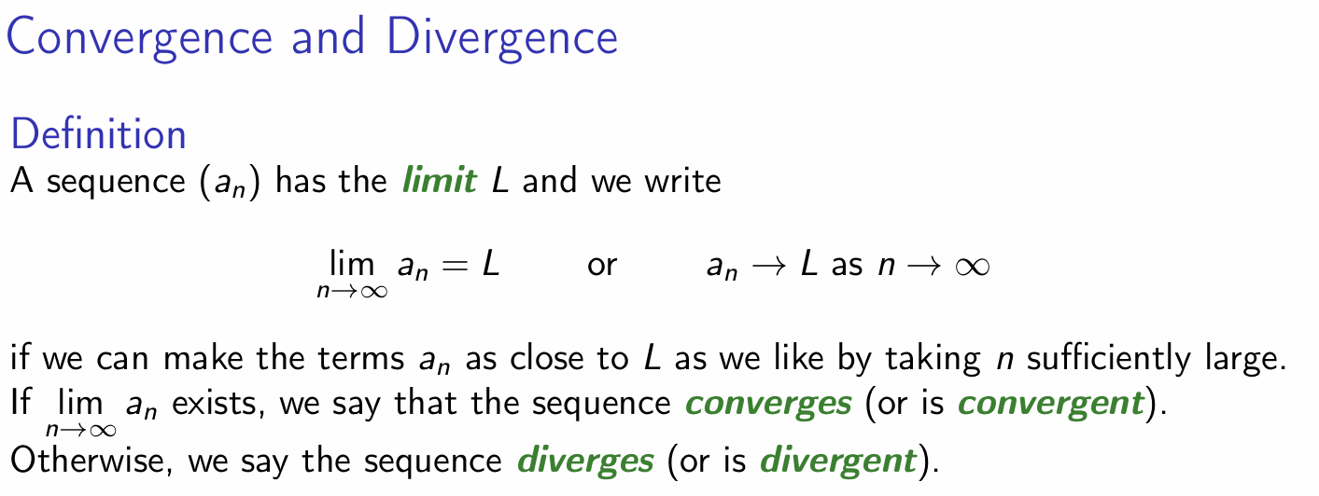
Sequences

Slide 5
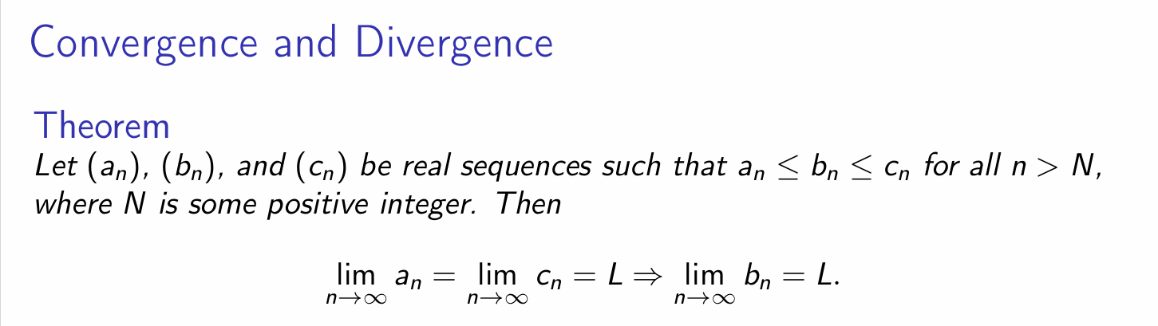
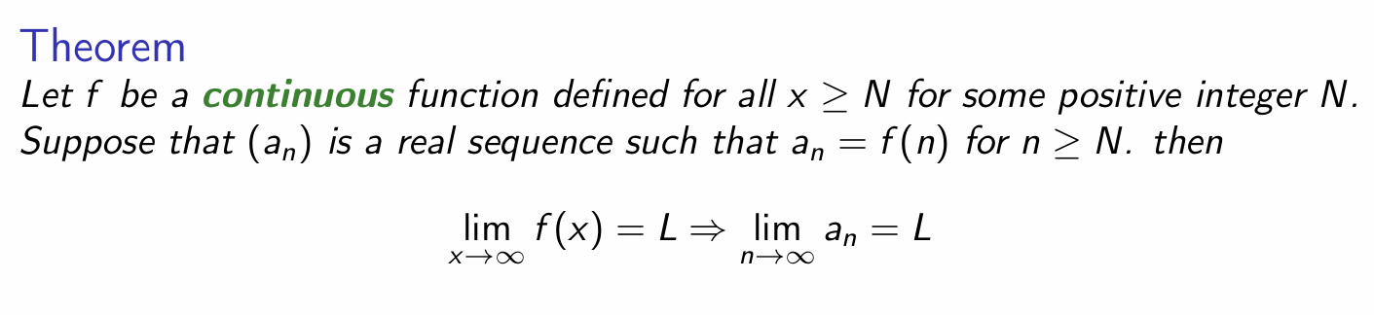
Sequences

Slide 6
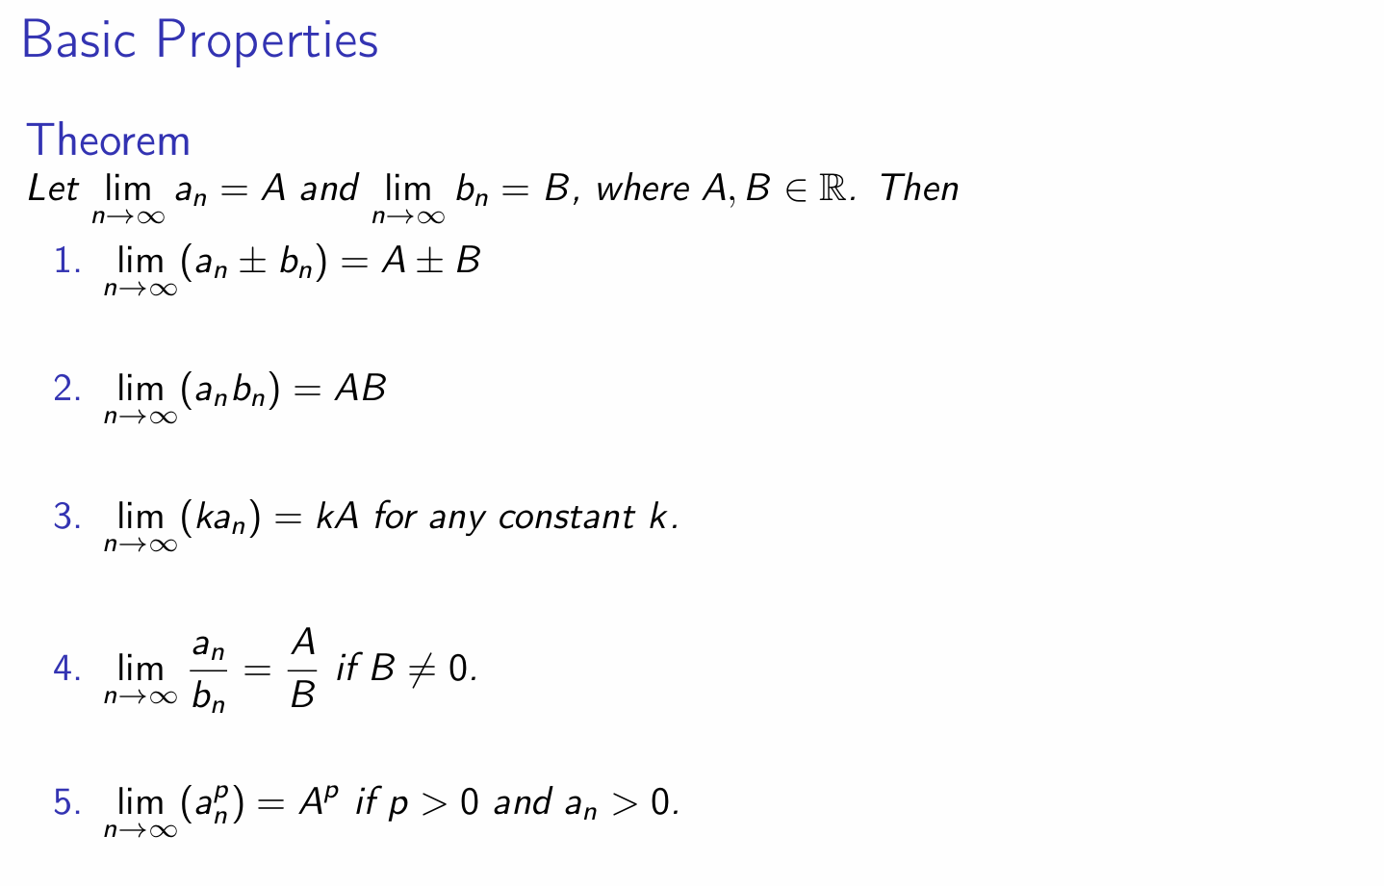
Sequences

Slide 7
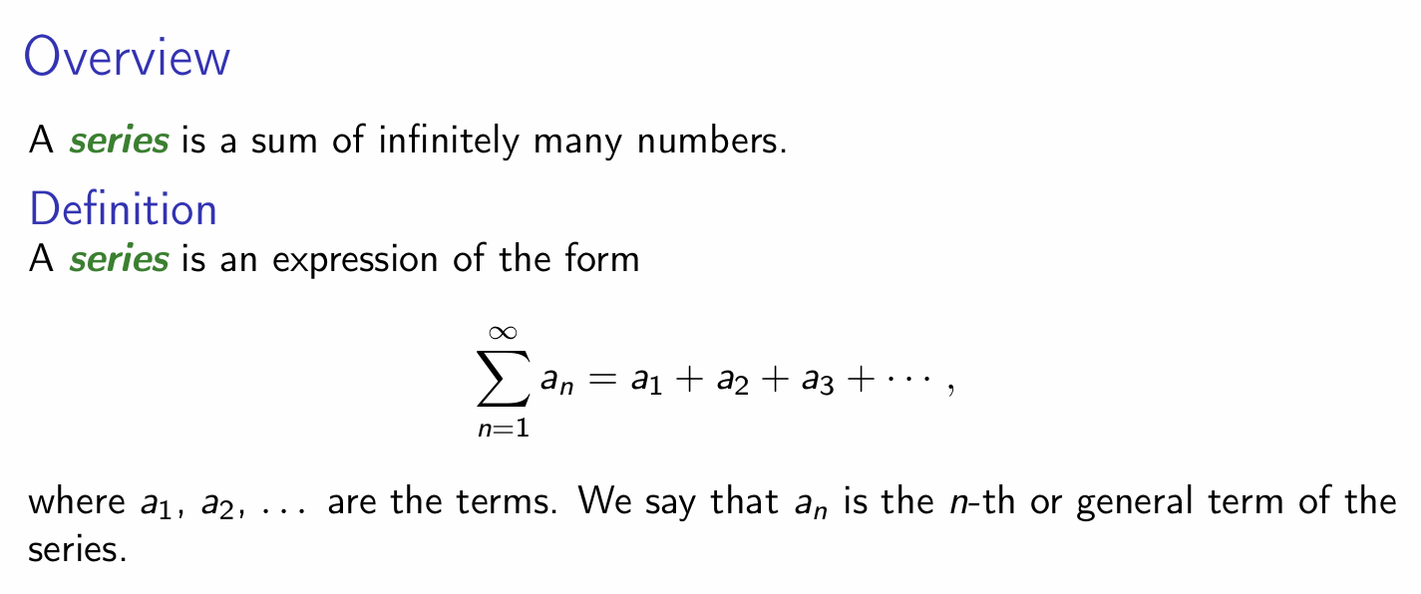
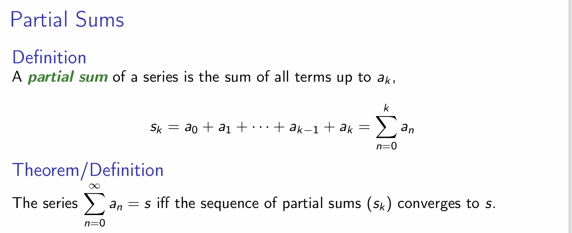
Series

Slide 8
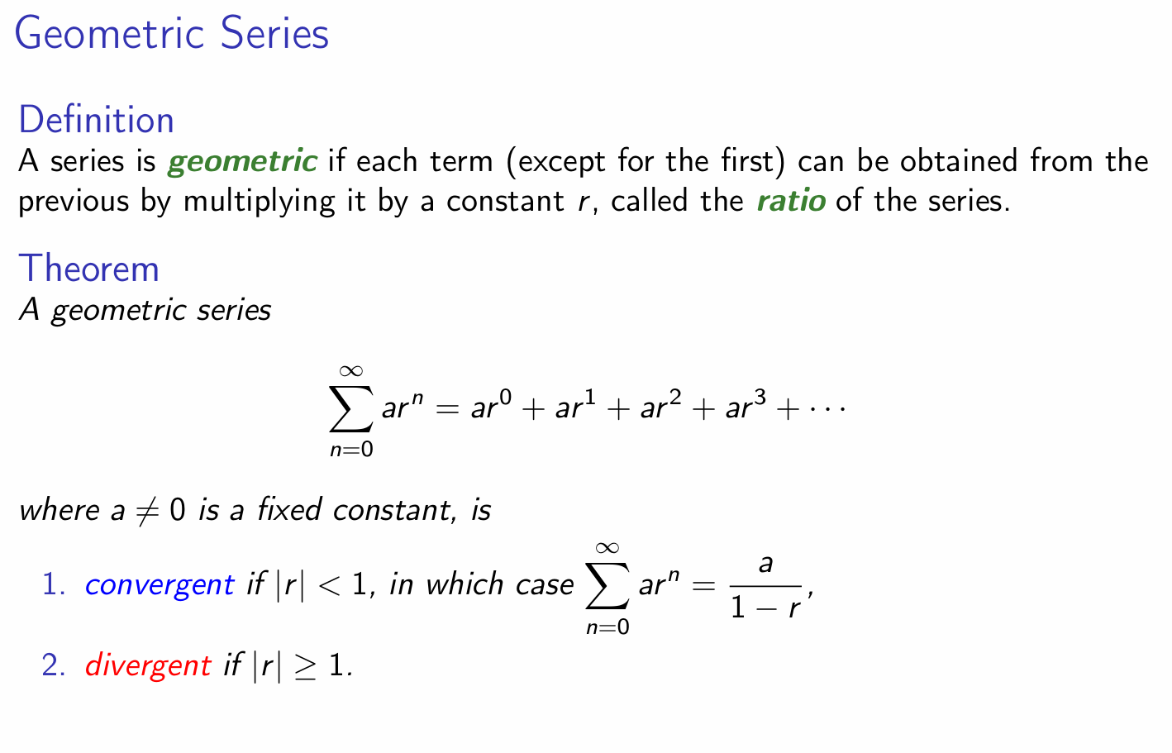
Series

Slide 9
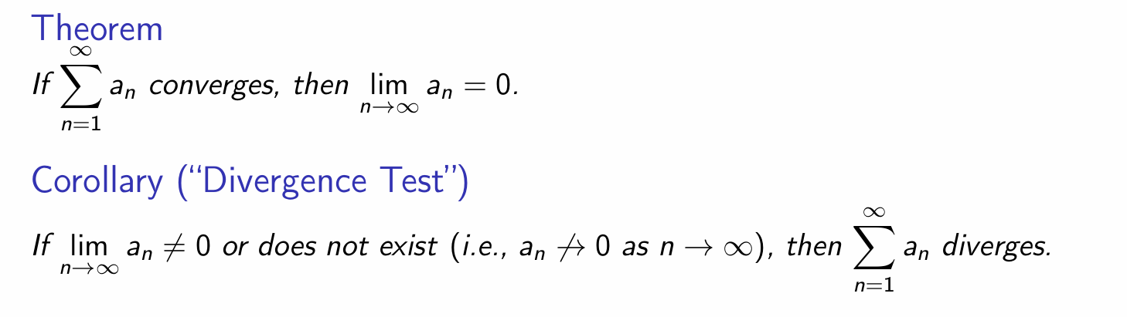
Series

Slide 10
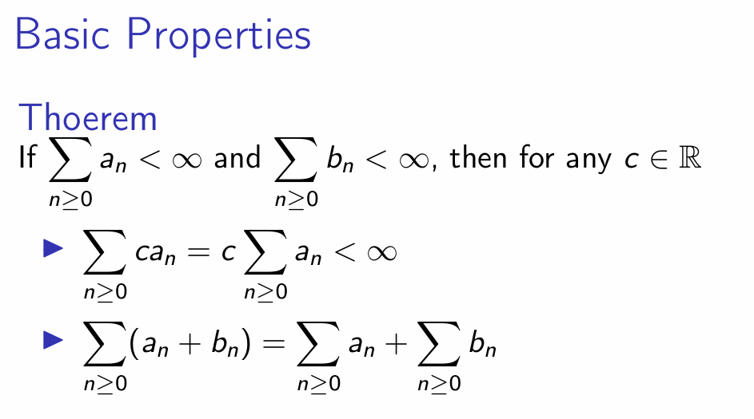
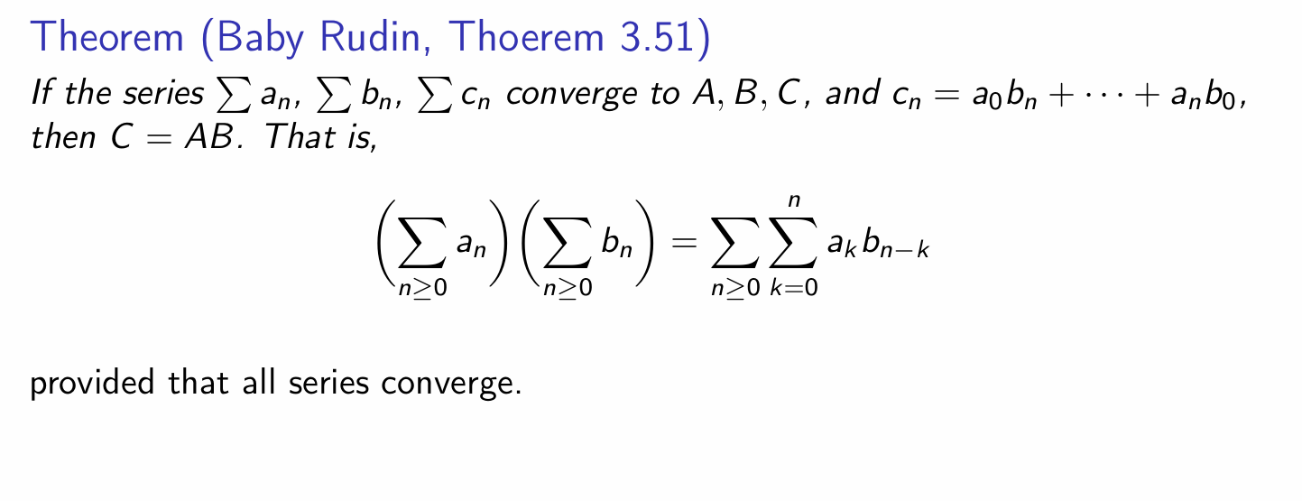
Series

Slide 11
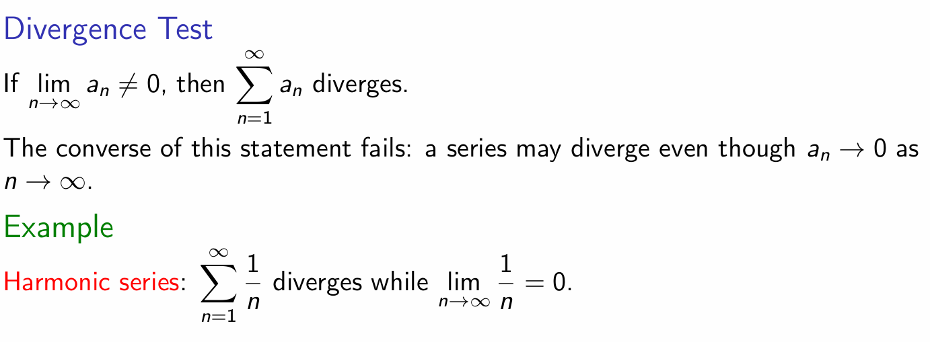
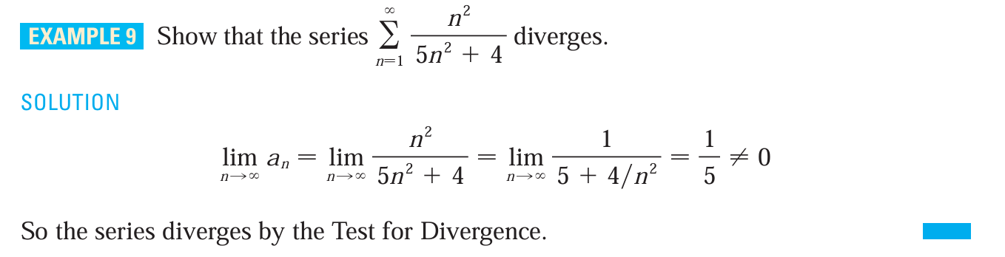
Test of Convergence (Very Important!!!)

Slide 12
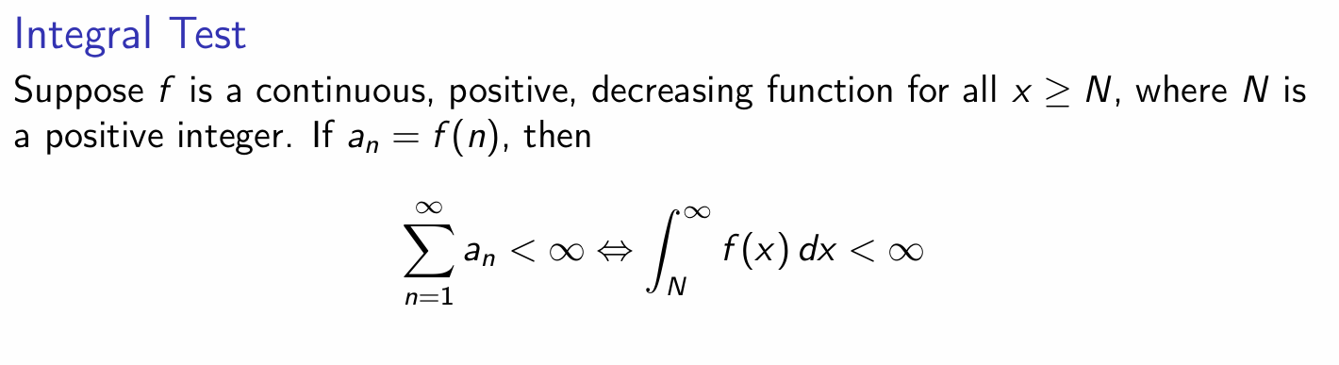
Test of Convergence (Very Important!!!)

Slide 13
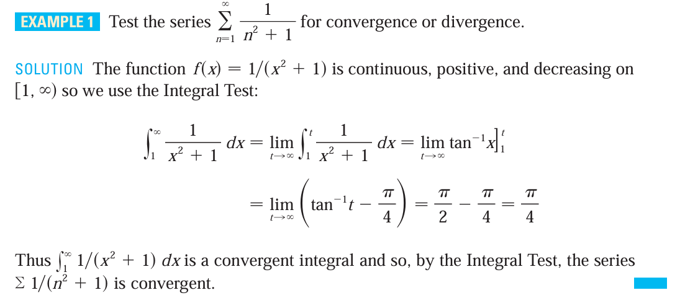
Example Time

Slide 14
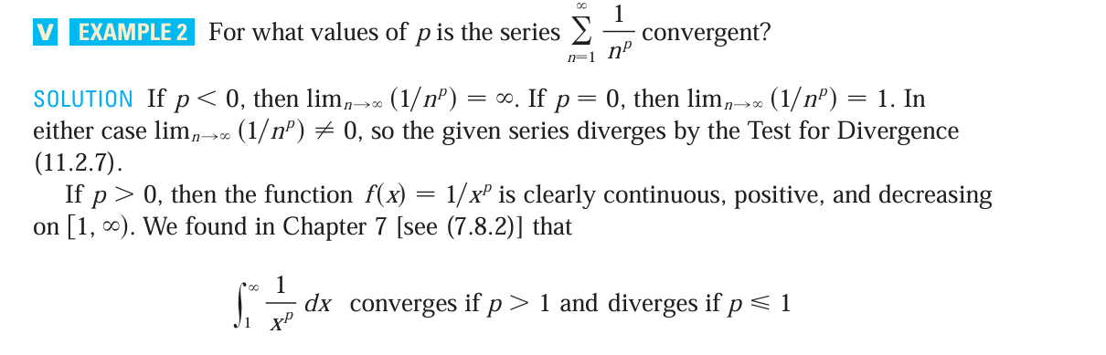
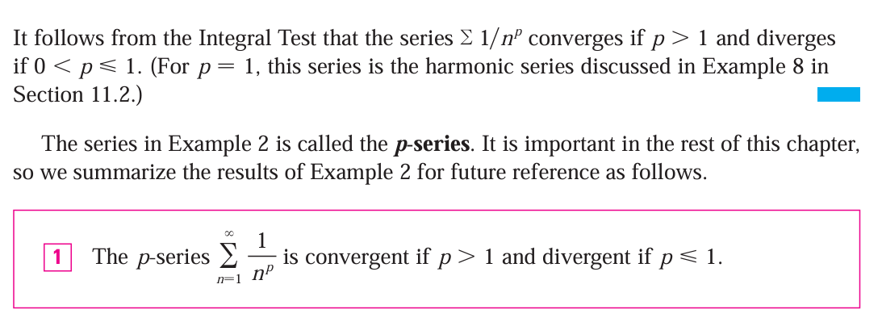
Example Time

Slide 15
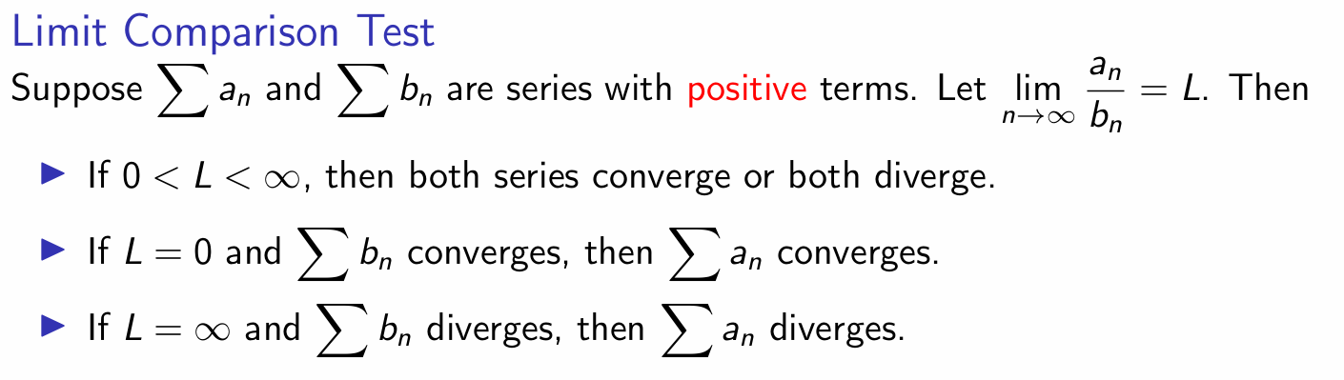
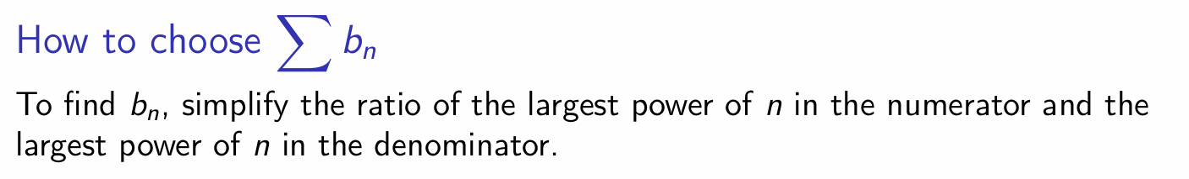
Test of Convergence (Very Important!!!)
Otherwise, it’s inconclusive, try other tests!
At most time, such test is used to test rational functions!

Slide 16
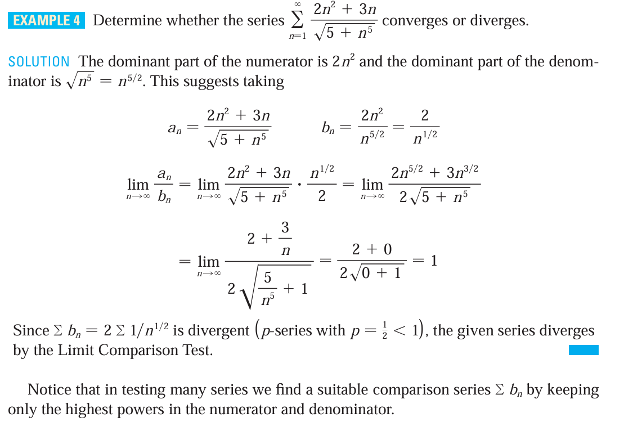
Example Time

Slide 17
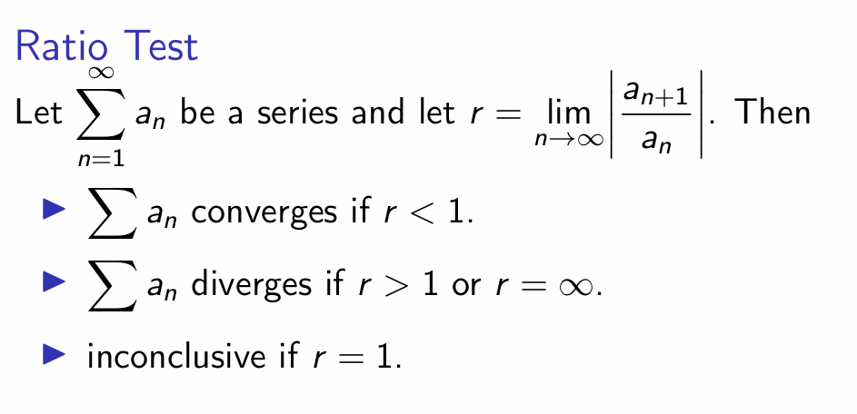
Test of Convergence (Very Important!!!)

Slide 18
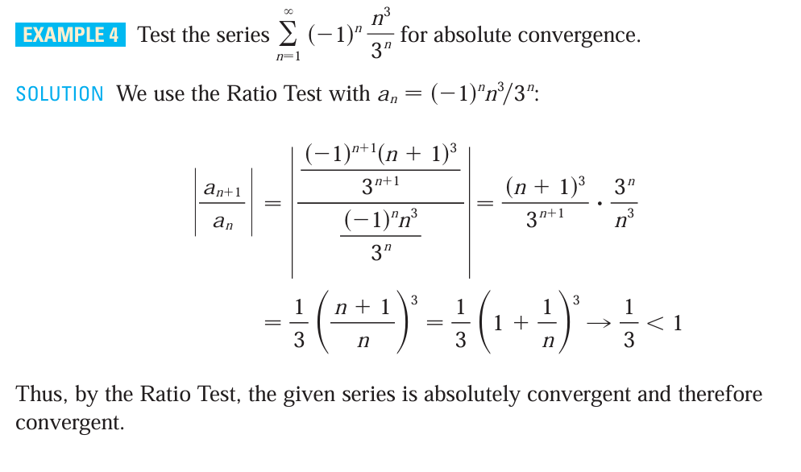
Example Time

Slide 19
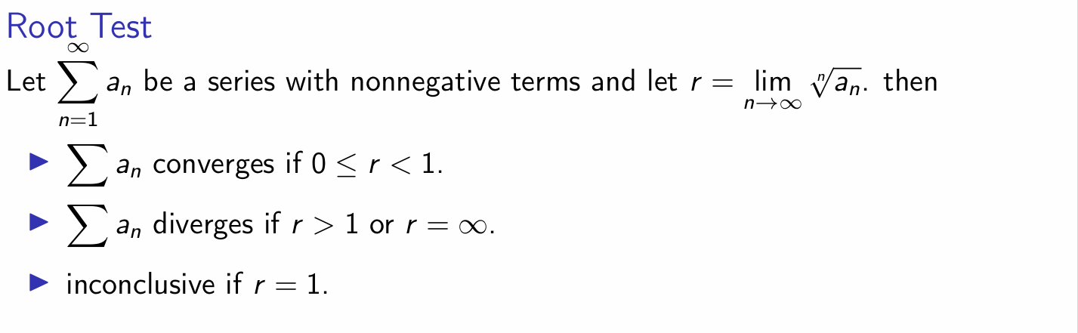
Test of Convergence (Very Important!!!)

Slide 20
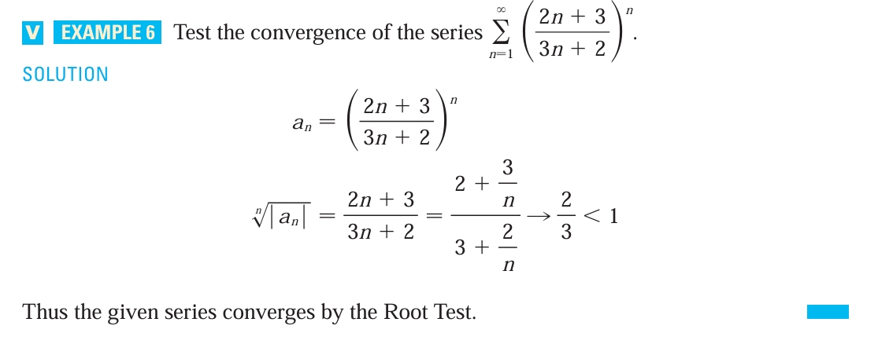
Example Time

Slide 21
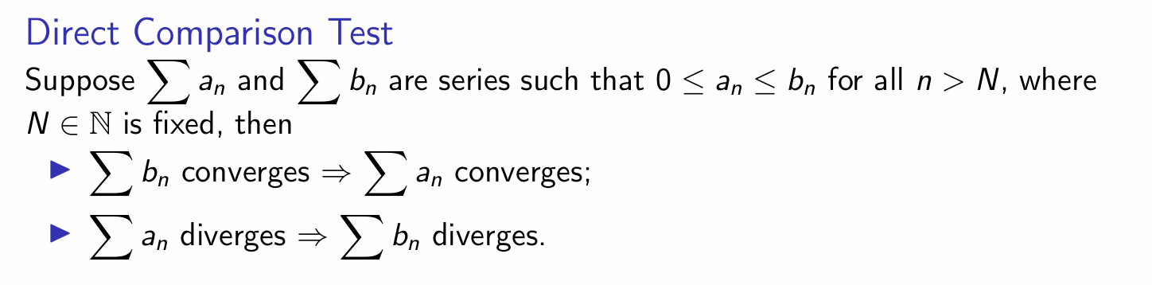
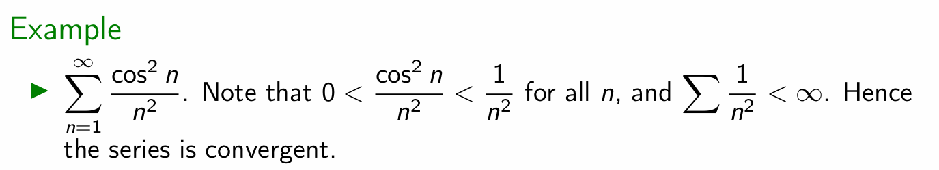
Test of Convergence (Very Important!!!)

Slide 22
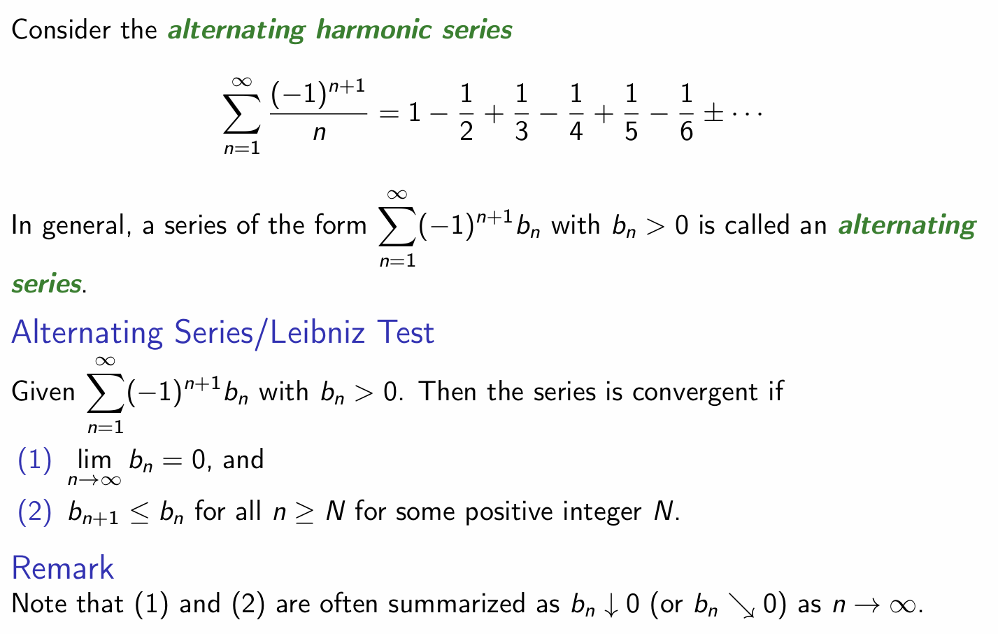
Test of Convergence (Very Important!!!)

Slide 23
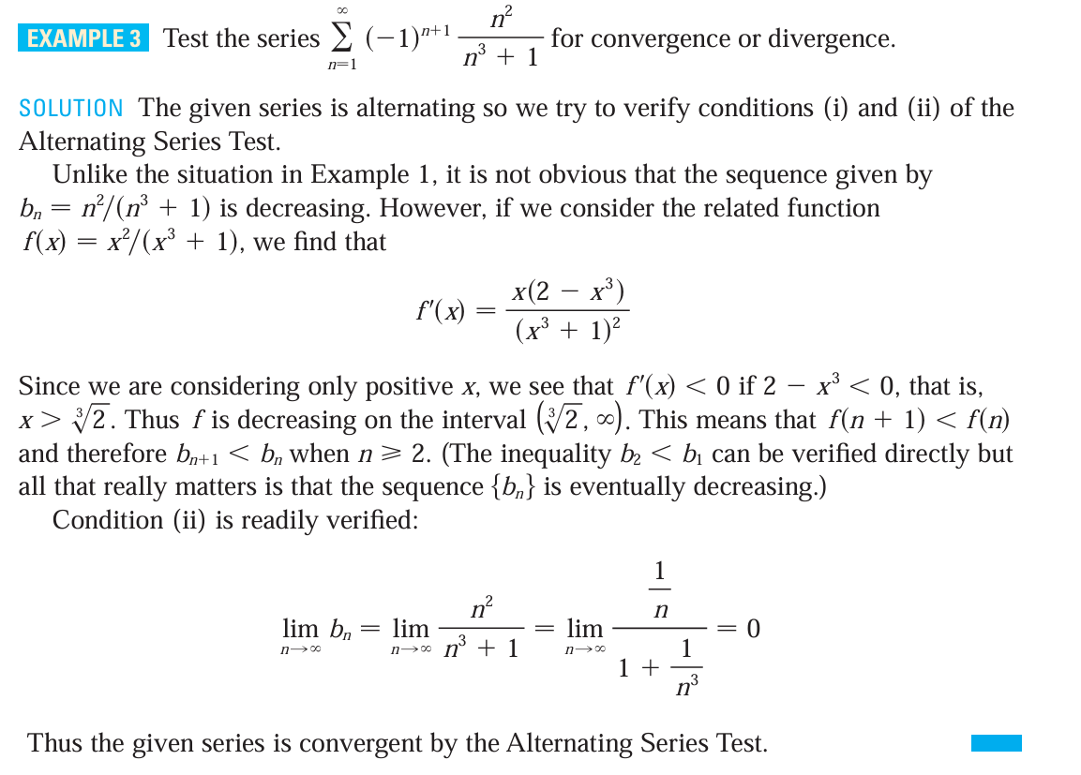
Example Time

Slide 24
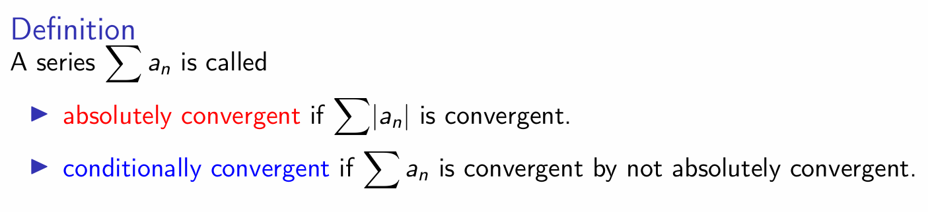
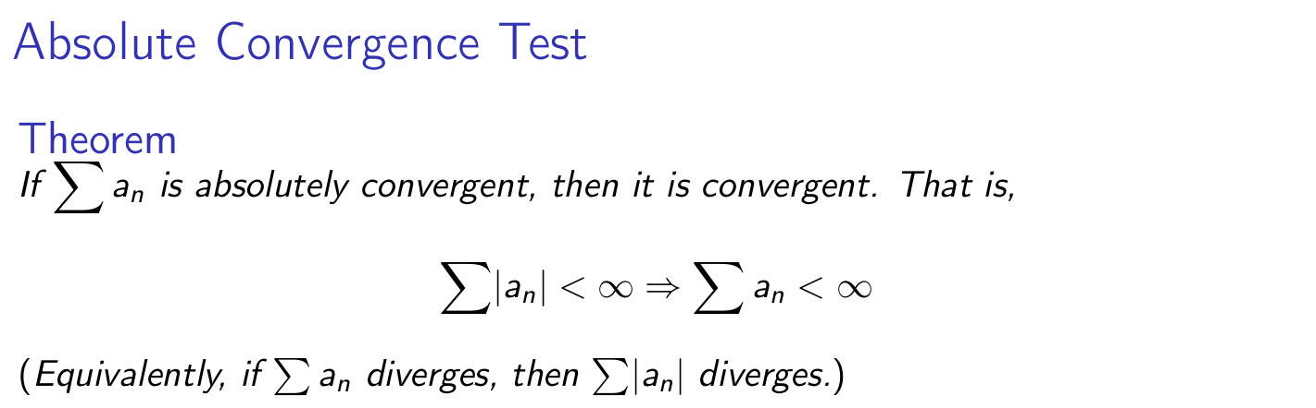
Test of Convergence (Very Important!!!)

Slide 25
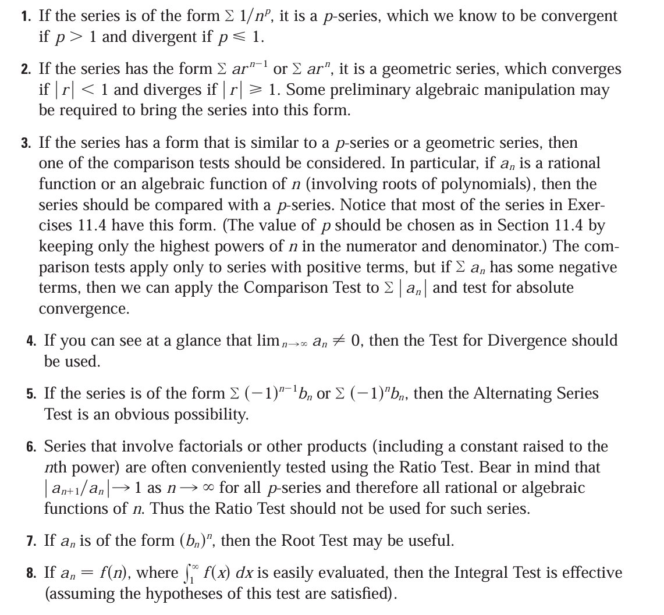
Strategy for testing of convergence

Slide 26
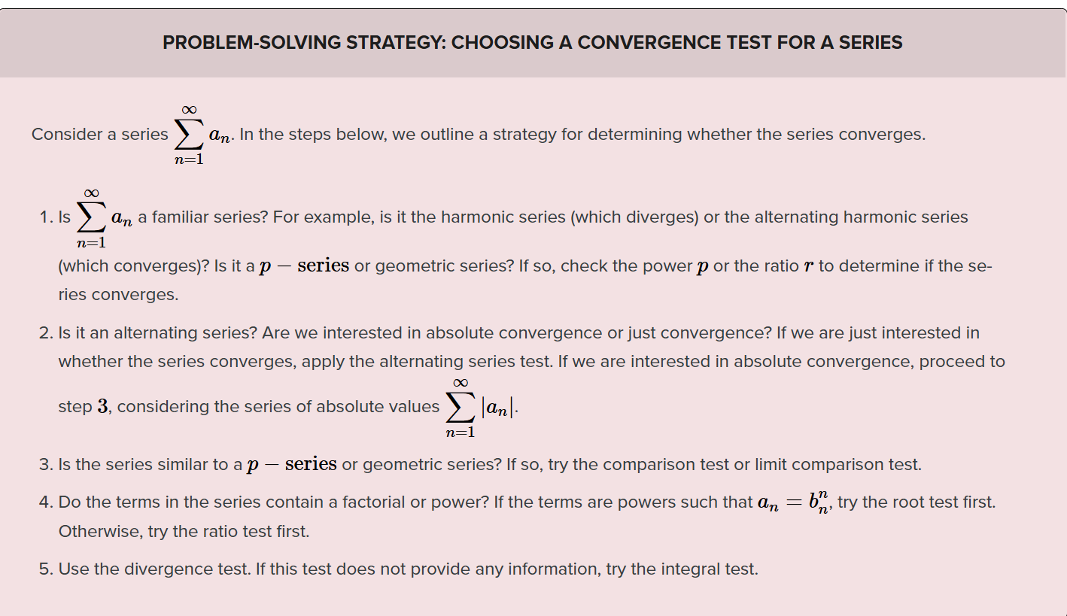
Strategy for testing of convergence
If you find the strategy listed in calculus is too long and you don’t want to read it, you can refer to this

Slide 27
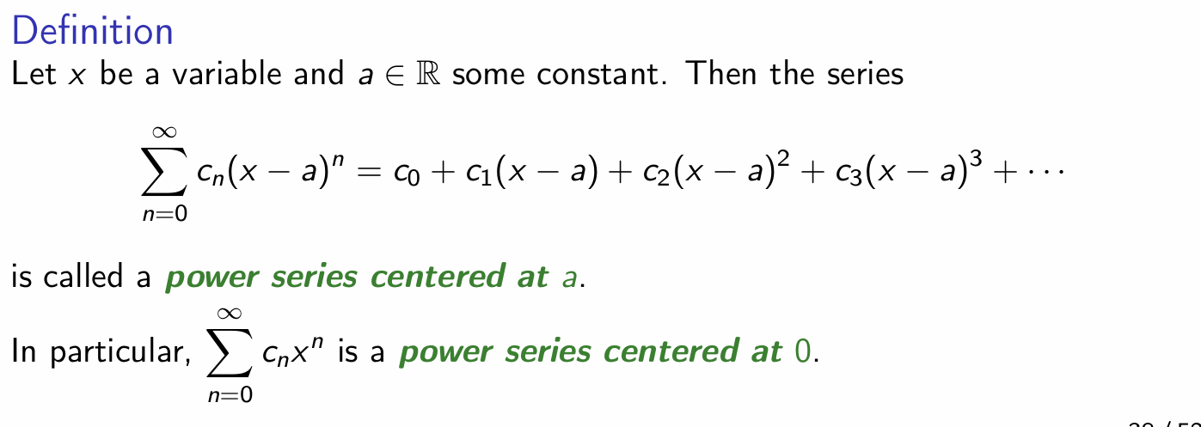
Power Series

Slide 28
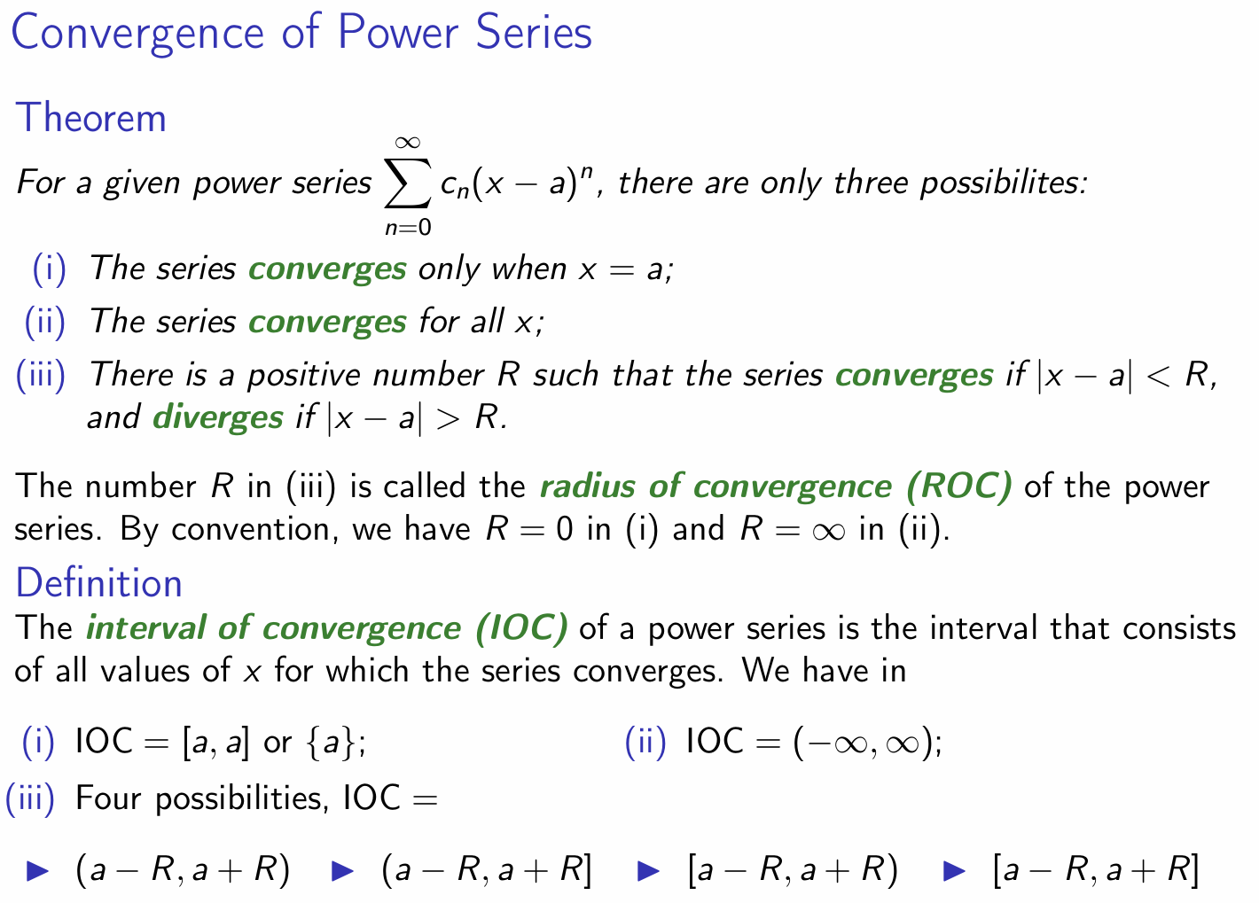
Power Series, IOC & ROC (Very Important!!!)
Check the boundary points separately!

Slide 29
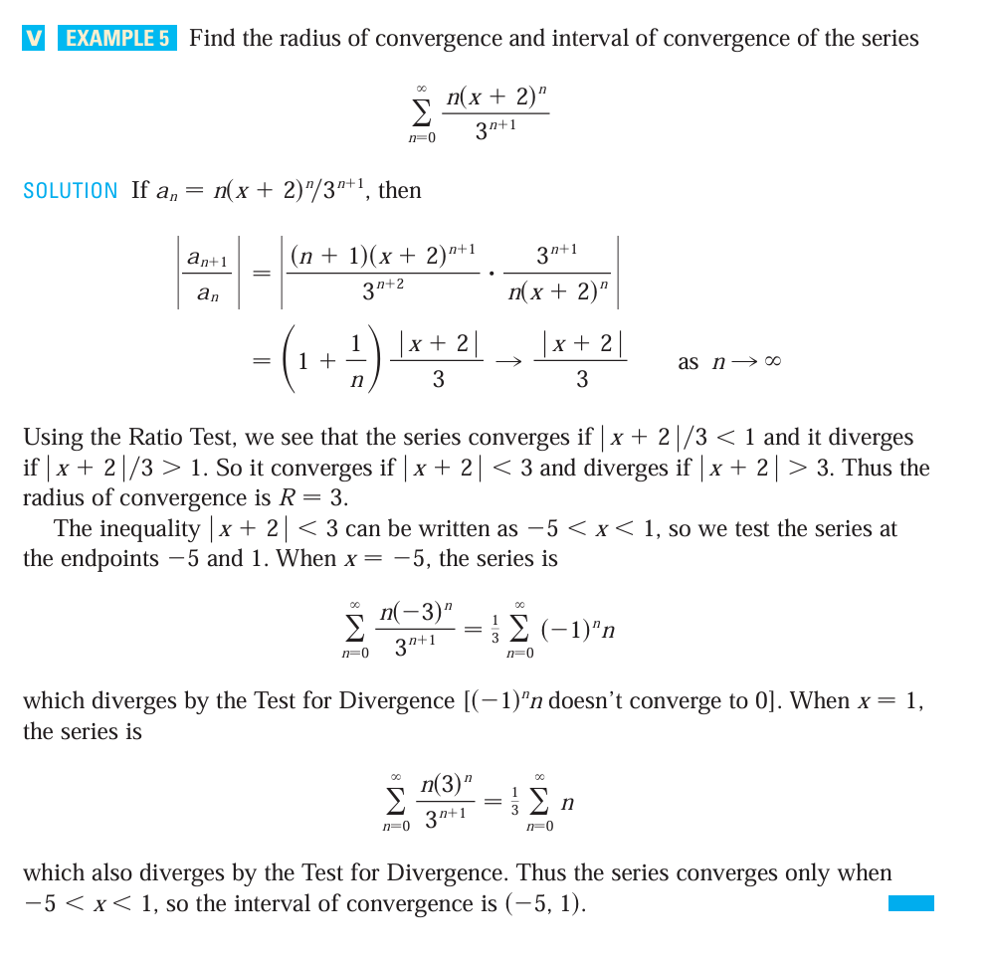
Example Time

Slide 30
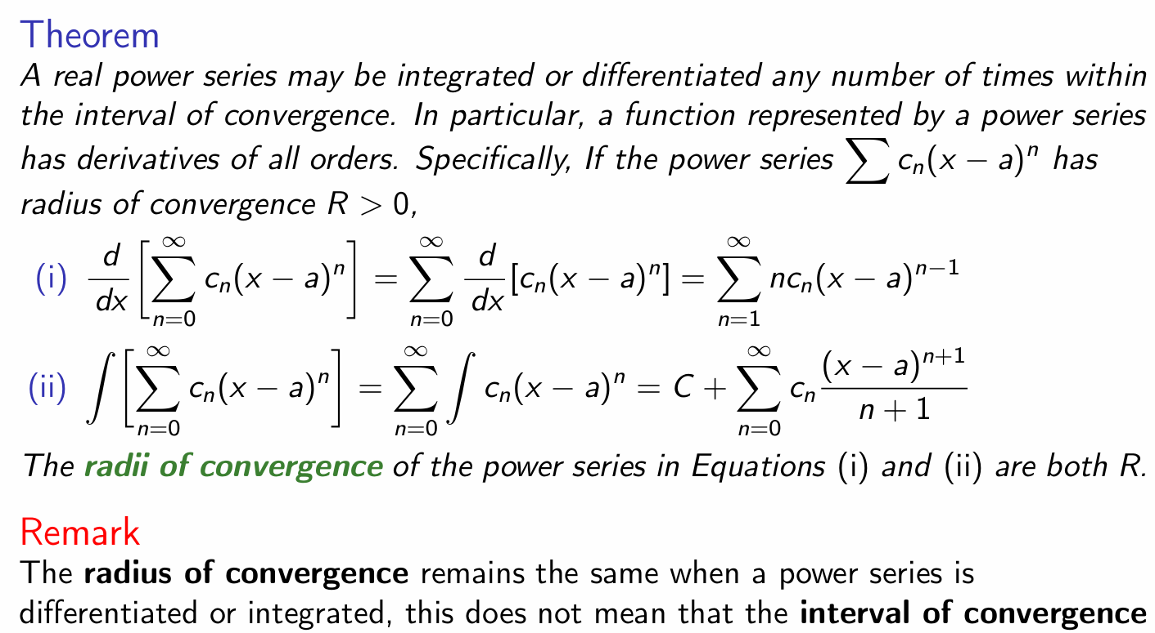
Power Series

Slide 31
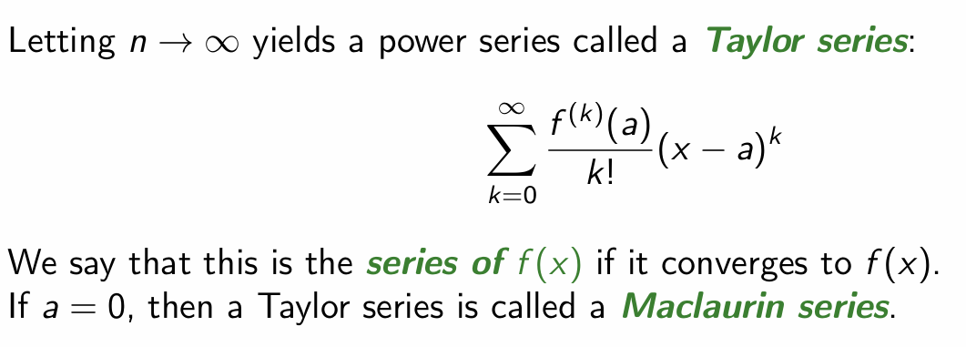
Taylor Series
If you find it’s hard for you to understand it, refer to
https://www.bilibili.com/video/BV1qW411N7FU/?p=11&share_source=copy_web&vd_source=3ec21da555ff4c3e17bc07dc4fde8604

Slide 32
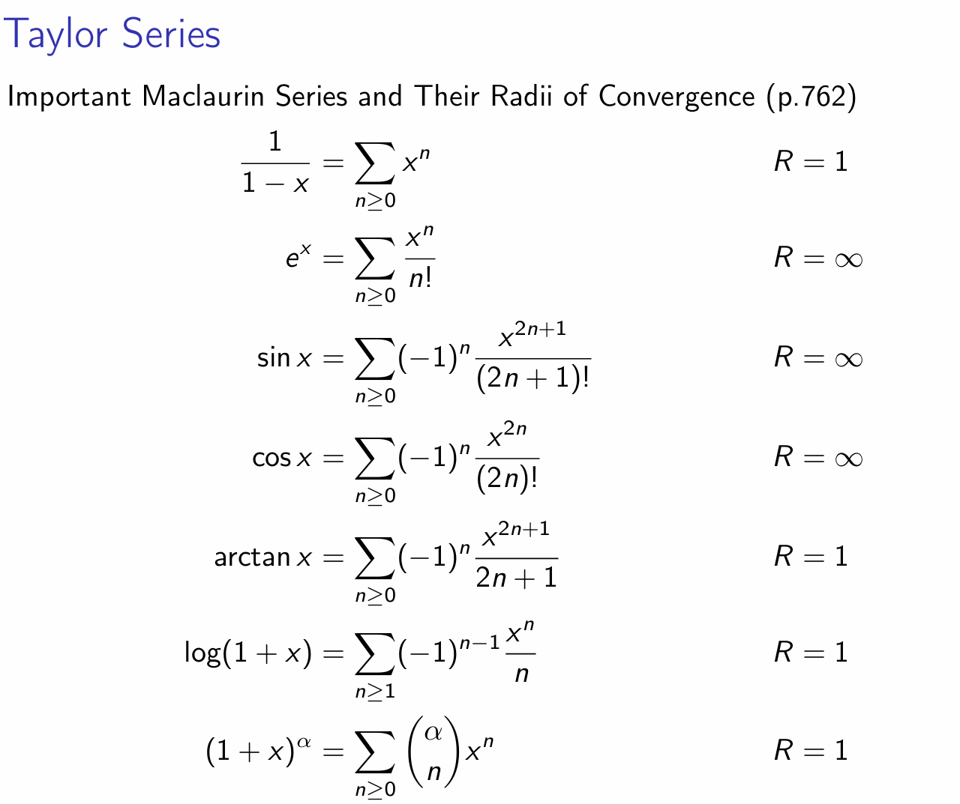
Taylor Series

Slide 33
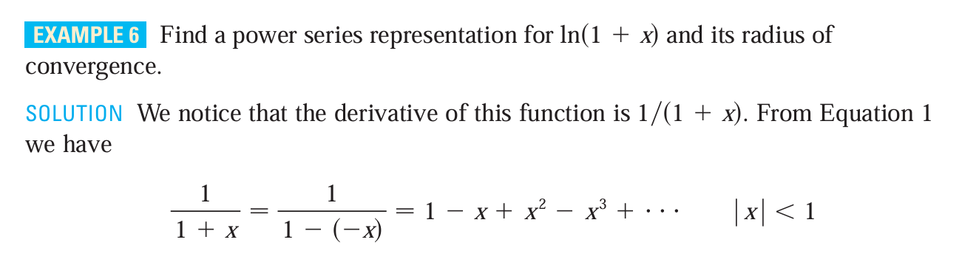
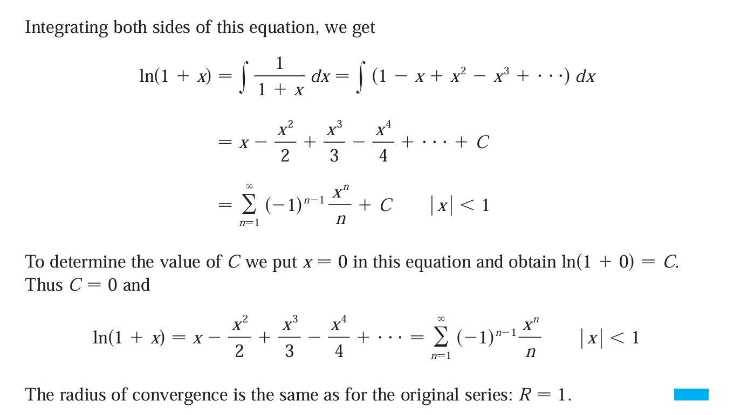
Example Time
If you find it hard to do such problems at first glance, you can try to find the derivate or integral of it.
Then you may find that you can use Taylor Series to expand the new function in series.
Finally, you can use the series you have got to get the series expression of the original function. (refer to slide30 and the example in the left)

Slide 34

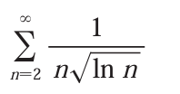
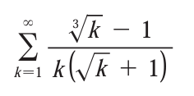
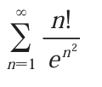
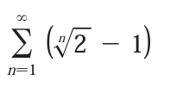
Exercises!

Slide 35
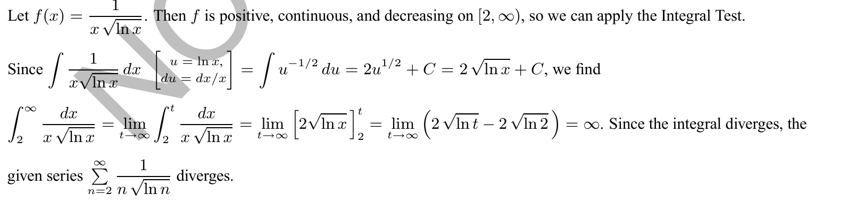
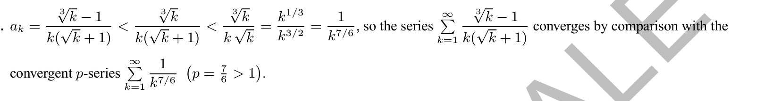
Solution

Slide 36
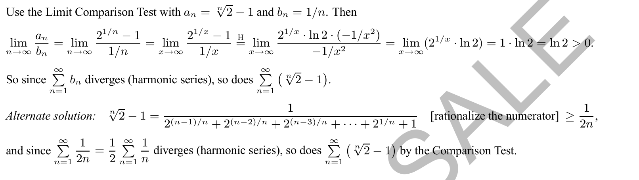
Solution

Slide 37
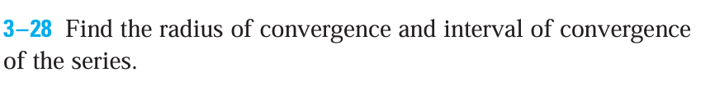




Exercises!

Slide 38


Solution

Slide 39


Solution

Slide 40


Exercises!
Find the IOC, ROC of the series
(Final 23FA)

Slide 41

Solution

Slide 42

Solution

Slide 43


Exercises!
In last year, such problems haven’t appeared in the exams, but this year Prof.Cai said that it might appear in the exam ,I’m not quite sure how it will be like in the exam.
These exercises are what I have found from calculus, you can refer to if you want to do some exercises.

Slide 44

Solution

Slide 45

Solution

Slide 46


Solution

Slide 47
Reference
James Stewart Calculus Early Transcendentals 7th Edition
VV156 24FA Lecture Slides, Runze Cai

Slide 48

THANK YOU AND GOOD LUCK！

